Slide 1
Quarter 4 Week 7

Slide 2
DiscoveryEd: Review the techbook for Physics! There will be videos and practice problems to help you. Feel good with physics? Move on to Weather unit!
Lightning Time

Slide 3
Tuesday June 6
Complete the half sheet warm-up on the Excretory System
Pull out your webquests
BYOD or Laptops to finish (half of class to do this)
Poems on the excretory system ☺ (second half of class)
Reminders:
No more current events
Grading window ends in 2 weeks – get in all missing work
Projects and labs are worth major grades – do them first!

Slide 4
Cinquain Poems
On the coffee filter, write a poem that reflects facts of the excretory system in the following format:
A Cinquain has 5 lines. The 1st line is a noun. The 2nd line is two adjectives describing the noun. The 3rd line is three verbs that have to do with the noun. The 4th line is a four word sentence. The 5th line is a synonym of the noun.
EXAMPLE:
Clouds
Fluffy, white
Drifting, floating, changing
Making animals up high
Cotton
Stamp in notebook, keep and show off your coffee filter poem!

Slide 5
June 7, 2017
Begin class with quiz on Digestive and Excretory System
Pass back papers
Reproductive System guided notes - stamp

Slide 6
Reproductive System
The Reproductive System allows the production of offspring
The reproductive system produces specialized cells: the female produces eggs; the male produces sperm. These specialized cells contain genetic material.
The female reproductive system has two functions: 1) to produce eggs and 2) to protect and nourish the offspring until birth
The pituitary gland stimulates eggs in the ovary to grow
An egg is release into the fallopian tube, where it may be fertilized, by a sperm cell
The egg moves to the uterus, where, if fertilized, it implants in the uterine wall
If not fertilized, the egg and the uterine lining exit the body through the vagina in a process called Menstruation
The male reproductive system contains the testes, which produce sperm, and the urethra, which is a canal through the penis. Sperm move through the urethra and exit the penis.

Slide 7
The production of offspring include fertilization, pregnancy, and birth
Fertilization is the joining of one egg cell and one sperm cell
Once fertilized the egg divides, producing an embryo. Cells in the embryo continue dividing
The embryo implants in the spongy lining of the uterus
During the nine months of pregnancy the embryo grows and develops, fed through the placenta
Labor and delivery
The first stage of birth begins with muscular contractions of the uterus
In the second stage, the cervix is fully dilated and the baby leaves the mother
In the third stage, the umbilical cord is cut and the placenta exits the body
Multiple births
single fertilized cell=identical twins
two fertilized eggs=fraternal twins

Slide 8
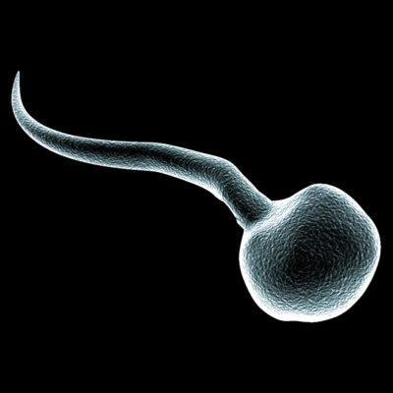
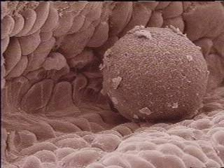
Sperm & Egg Cells

Slide 9
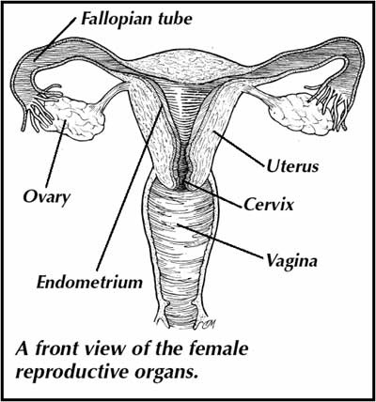
Female Reproductive System

Slide 10
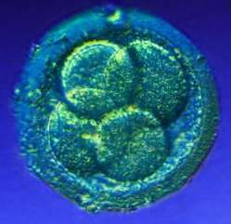
Zygote 1st day until 4th day

Slide 11
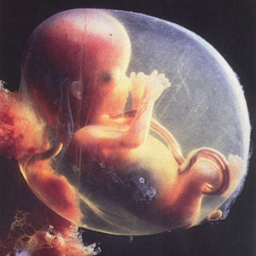
Embryo 4th day until 8th week

Slide 12
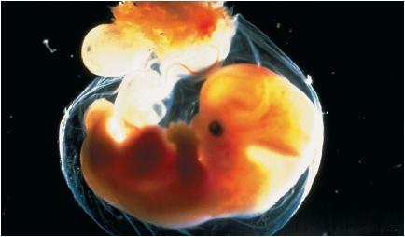
Embryo at 5 weeks

Slide 13
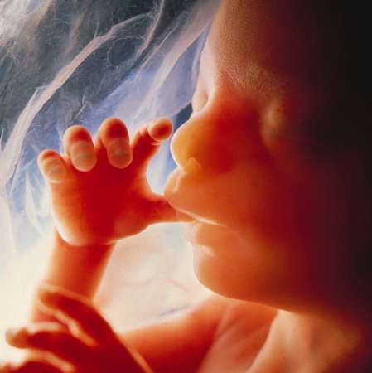
Fetus 9th week until birth

Slide 14
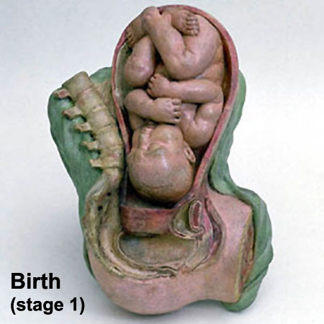
Fetus at Birth

Slide 15
Reproductive Hormones
BrainPop - Puberty
List out all the hormones associated with the reproductive system & what they do

Slide 16
Thursday June 8th
BrainPop on the Reproductive System
Meiosis Video/Interactive and diagramming
Venn Diagram in notebook comparing/contrasting Mitosis & Meiosis

Slide 17
Friday June 9th
Final questions on Reproductive system?
Quiz on Monday related to the reproductive system
Begin Final Human Body Systems project
Due Wednesday June 14th at the End Of Class
NOTE: Notebook checks happening Monday-Wednesday of next week while you work on your projects

