Slide 1
Quarter 3 Week 6

Slide 2
Monday February 27th
Cells Unit Test

Slide 3
Lightning time
Make sure you have finished the ScienceWorld packet and turned it in!
Choose 1 type of cell and draw out a model of it, labeling key organelles
Make a list of supplies THAT YOU HAVE ACCESS TO that could represent the parts of the cell
Bring in materials and BUILD ☺
Prize for the BEST MODEL – as chosen by you!

Slide 4
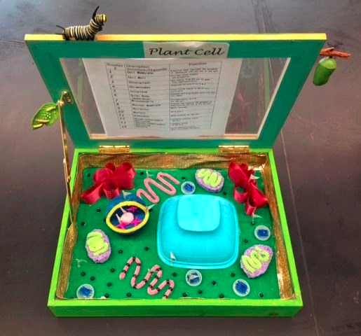
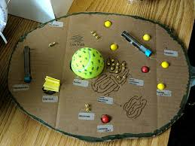
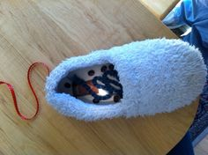
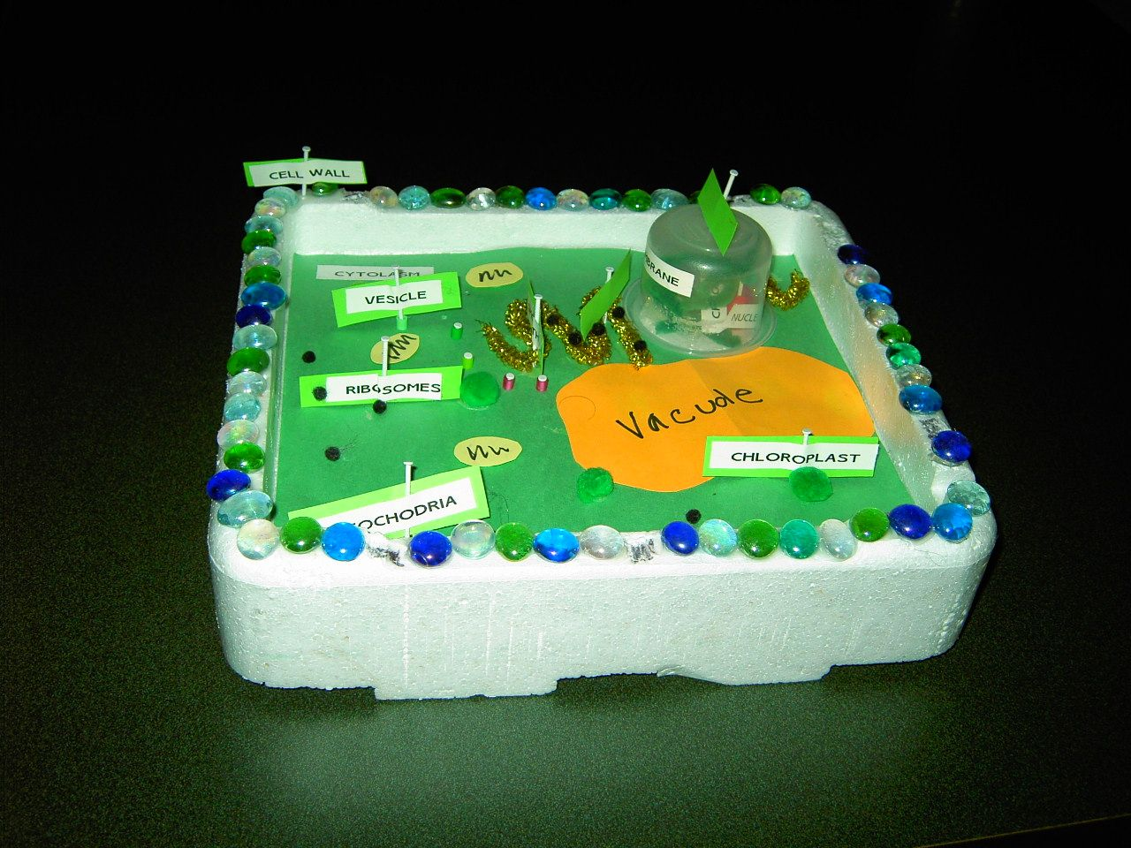
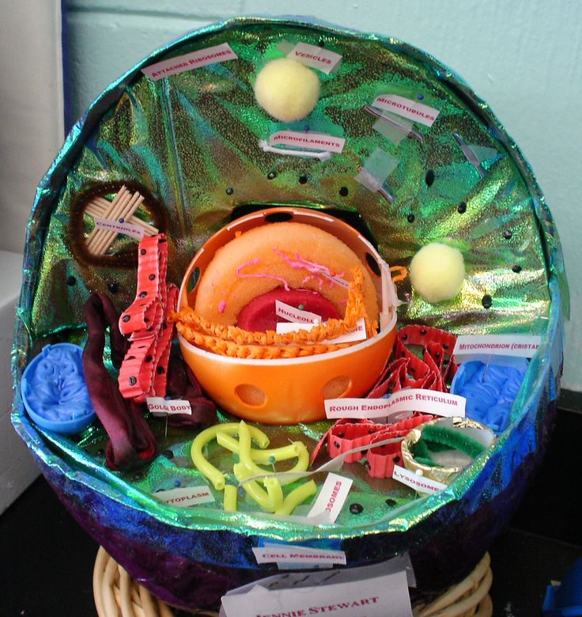
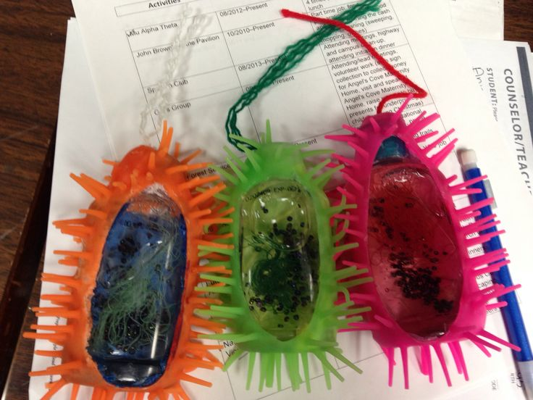

Slide 5
Tuesday February 28th
Group project work day!
We will see how many of you finish today to begin presentations tomorrow ☺
Extra credit for those who “win” the money to develop their “cure”
We will be doing group peer evaluations too, so make sure you are all doing your part to ensure a successful project!

Slide 6
Your “Cure” Details
Identify a function in cancerous cells not found in normal cells that you can target as a cancer treatment. In your presentation, address:
What is it?
How it works
Side effects
Anticipated length of treatment
Does this work for genetic cancers, environmental cancers, or both? How?

Slide 7
Wednesday March 1st - Friday March 3rd
Group presentations
4 of you will be deemed the “medical board” and will peer review the group presenting
Everyone needs to come up with 2 quality questions to ask each group as they present. Write them in your spiral notebook – I will call on you at the end to share out.

