Slide 1
Quarter 3 Week 1
Cells unit

Slide 2
January 23rd! Characteristics of Living Things
We will watch a video
Record each Characteristic in your notebook
Notes:
Video with a great explanation of unicellular, multicellular and the characteristics of living things. Stop the video after the explanation of uni and multicellular...let students discuss it and create something in their notebooks that will help them remember the difference. Encourage creativity. After each characteristic of life presented, stop the video and have students discuss, even act out kinesthetically, that particular characteristic. Before starting the video again, allow students time to write in their notebooks a way they will remember.)

Slide 3
Are Cars Living??
Pair up and work out the Martian and the Car activity.
Complete in your notebook, then I will assign you a side (Defense or Prosecution) and write out your argument on a white board – how good is your evidence to win the case?

Slide 4
Lightning time
Finish crossword puzzle for the Science World magazine
Gather a packet to look deeper into the Antibiotic Resistance article
All parts should be finished by Friday ☺

Slide 5
Warm up January 24th
On a separate sheet of paper – complete the following prompt in 4-8 sentences:
Prove why an automobile is considered a non-living thing.

Slide 6
January 24th & 25th BYOD – Cell Theory: Historical Timeline
Individually – using your device or one of my computers, watch the video and complete the given timeline
Second – complete the questions and your OWN timeline in the space provided
This is due TOMORROW!

Slide 7
Warm up January 26th
FreeWrite!
Watch the video and do a 3 minute freewrite ☺

Slide 8
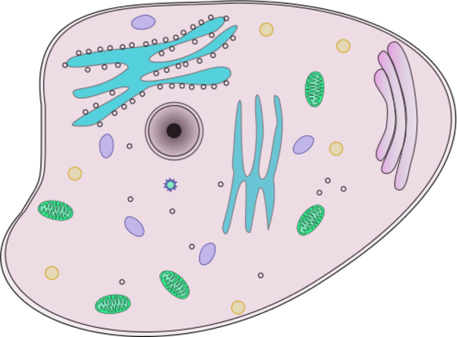
January 26th Eukaryotic vs. Prokaryotic
In pairs – read through the text and individually answer the questions in your notebook. YES – COMPLETE SENTENCES!
Exit ticket = Venn Diagram!

Slide 9
January 27th Parts of the microscope
Let’s review the parts and proper usage of MICROSCOPES ☺
Complete the worksheet and put in your notebook.
Visit 2 microscopes and make observations – use a Petri Dish to draw 2 perfect circles to be your “Field of View”
GOOD OBSERVATIONS = GOOD DRAWINGS

